Slide 1
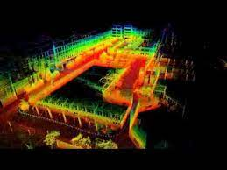
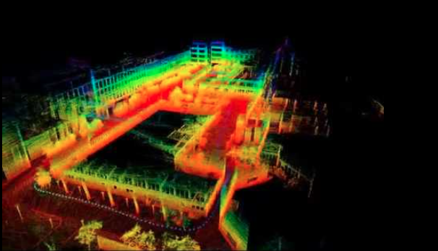
Group 3
Shayak Bhadraray, Narayanan Ramasamy, Adithya Ramesh, Chirag Dhoka Jain
LIO-SAM
Tightly Coupled Lidar-Inertial Odometry via Smoothing and Mapping

Slide 2
Introduction:
Simultaneous localization and mapping (SLAM) is the process of constructing a map of an unknown environment while concurrently keeping track of the agent's location
What are the Key challenges of SLAM?
Lidar-based simultaneous localization and mapping (SLAM) methods have become popular for accurate 6DOF state estimation. However, methods like lidar odometry and mapping (LOAM) suffer from drift over long durations and lack flexibility for sensor fusion.
We thus investigate a lidar inertial odometry framework via smoothing and mapping (LIO-SAM) based on a factor graph optimization approach to address these challenges

Slide 3
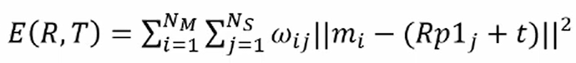
What is Lidar Odometry?
Lidar odometry is typically performed by finding Relative transformation between two consecutive frames using scan-matching methods such as ICP.
ICP stands for Iterative Closest Point. It minimizes squared errors between two point clouds.
How ICP algorithm works
P1: initial point cloud, P2: second point cloud
1. Computation of the nearfest point in P1 for every point in P2 using Euclidean Distance
2. If the distance di > threshold, the given pair of points is removed.
3. Weights are added to pairs of points.
4. Computation of rotation matrix R and translation vector T using the least square method.
5. Computation of transformation of the set P1 using matrices - R * p1j +T
6. Computation of error iterates until required accuracy

Slide 4
Problem with Lidar Scan
Point cloud is skewed because of the rotation mechanism of 3D lidar.
Using only a lidar for pose estimation is not ideal since registration using skewed point clouds or features will eventually cause large drift.
Therefore, lidar is typically used in conjunction with other sensors, such as IMU and GPS, for state estimation and mapping.
Two ways for sensor fusion
Loosely-coupled fusion: IMU is introduced to de-skew lidar scan and give motion prior for scan-matching. However, the IMU is not involved in optimization process of the algorithm.
Tightly-coupled fusion: Tightly-coupled systems usually offer improved accuracy. Measurements from both the lidar and IMU are used for joint- optimization.

Slide 5
How LIO-SAM Works
LIO-SAM estimates the state of the robot and its trajectory using observations of lidar, IMU and optionally GPS sensors.
This state estimation problem can be formulated as a maximum a posteriori (MAP) problem.
A factor graph is used to model this problem. Four types of factors and one variable type are used for factor graph construction.
Variable representing the robot's state at a specific time is attributed to the nodes of the graph.
Four types of factors:
1. IMU preintegration factor: Inferring the motion of the robot using measurements from the IMU.
2. Lidar odometry factor: Feature extraction, keyframe selection and relative transformation.
3. GPS factor: The system suffers from drift during long duration navigation tasks. To eliminate drift, sensors such as GPS that offer absolute measurements are required.
4. Loop closure factor: Euclidean distance based loop closure detection approach is used

Slide 6
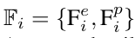
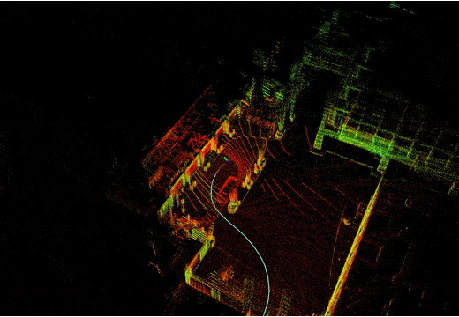
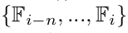
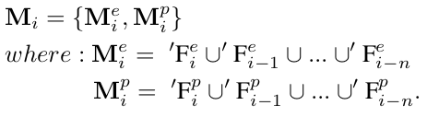
Components of LIO SAM (LIDAR Odometry):
Feature extraction:
Extract edge and planar features from each scan, .
Keyframe selection:
If change in robot pose exceeds a user-defined threshold (1m and 10°), select as keyframe.
Sliding window approach:
Consider n most recent keyframes, .
Transform to world frame and merge to form voxel map.
Eliminate duplicate features that fall in the same voxel.
The downsample resolutions for edge and planar features are 0.2m and 0.4m, respectively.
Figure 2 : Lidar scanning in LIO SAM
Notes:
Explanation : Lidar Odometry
Extracts edge and planar features from each lidar scan
The lidar scan goes through a feature extraction process to identify edge and planar features
This is done by evaluating the smoothness/roughness of points in a local region
Rough points are classified as edges, smooth points as planes
Requires point timestamp for deskewing
The timestamp indicates the relative time within a scan, e.g. 0 - 0.1 sec for a 10Hz lidar
As the lidar rotates during a scan, points are distorted based on rotation speed
The timestamp allows transforming points to the start of the scan to deskew
This accounts for motion distortion during the scan interval
Requires point ring number
The ring number tells us which channel of the lidar sensor each point came from
Important for organizing points correctly in a matrix representation
Enables processing related to the lidar geometry
Ring number should match the specifics of the lidar sensor used
Matches current scan to recent keyframes to estimate motion
Scan matching finds the incremental motion between scans
Current scan is matched to recent keyframe scans
Provides local, precise relative motion estimates
But suffers from drift accumulation over time
Provides precise relative motion, but drifts over time
Suffers from distortion during fast motion

Slide 7
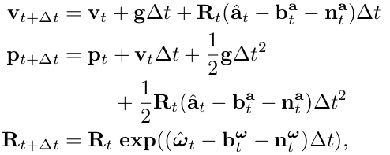
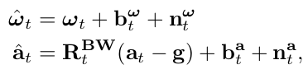
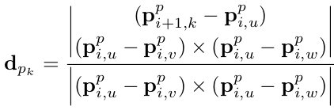
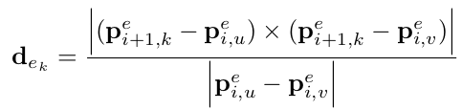
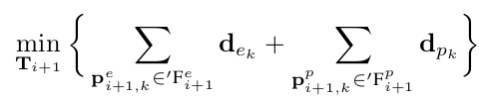
Components of LIO SAM (LIDAR Odometry):
Scan matching:
Match current scan to recent lidar keyframes to estimate the relative transformation.
Need to transform current scan from body frame to world frame.
This, requires us to predict robot motion using IMU.
Solve for the optimal transformation by minimizing distance between matching features.
Figure 2 : Lidar scanning in LIO SAM
Notes:
Explanation : Lidar Odometry
Extracts edge and planar features from each lidar scan
The lidar scan goes through a feature extraction process to identify edge and planar features
This is done by evaluating the smoothness/roughness of points in a local region
Rough points are classified as edges, smooth points as planes
Requires point timestamp for deskewing
The timestamp indicates the relative time within a scan, e.g. 0 - 0.1 sec for a 10Hz lidar
As the lidar rotates during a scan, points are distorted based on rotation speed
The timestamp allows transforming points to the start of the scan to deskew
This accounts for motion distortion during the scan interval
Requires point ring number
The ring number tells us which channel of the lidar sensor each point came from
Important for organizing points correctly in a matrix representation
Enables processing related to the lidar geometry
Ring number should match the specifics of the lidar sensor used
Matches current scan to recent keyframes to estimate motion
Scan matching finds the incremental motion between scans
Current scan is matched to recent keyframe scans
Provides local, precise relative motion estimates
But suffers from drift accumulation over time
Provides precise relative motion, but drifts over time
Suffers from distortion during fast motion

Slide 8
Components of LIO SAM (LIDAR Odometry):
Requires point timestamp for deskewing:
Relative time within scan (e.g. 0 - 0.1 sec for 10Hz)
Used to transform points to start of scan
Requires point ring number:
Indicates which sensor channel point is from
Used to organize points in a matrix
Provides precise relative motion, but accumulates drift over time
Suffers from point cloud distortion during fast motion
Figure 2 : Lidar scanning in LIO SAM

Slide 9
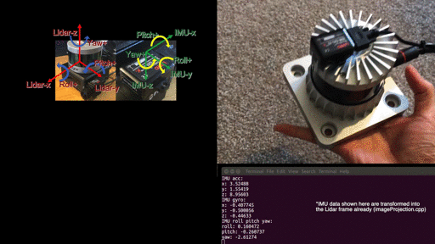
Components of LIO SAM (Inertial Measurement Unit):
IMU provides high-rate angular velocity and linear acceleration
Used to de-skew lidar scans and provide motion prediction
Requires 9-axis IMU (or 6-axis with init like VINS-Mono)
High rate (200+ Hz) improves accuracy
Bias estimation enables long-term accuracy
Must align IMU frame to lidar frame
Provide correct extrinsic calibration
Robust to fast motion, but drifts over time
May need separate calibrations for accel/gyro and attitude
Figure 3 : IMU Calibration for LIO SAM
Notes:
IMU requirement. Like the original LOAM implementation, LIO-SAM only works with a 9-axis IMU, which gives roll, pitch, and yaw estimation. The roll and pitch estimation is mainly used to initialize the system at the correct attitude. The yaw estimation initializes the system at the right heading when using GPS data. Theoretically, an initialization procedure like VINS-Mono will enable LIO-SAM to work with a 6-axis IMU. (New: liorf has added support for 6-axis IMU.) The performance of the system largely depends on the quality of the IMU measurements. The higher the IMU data rate, the better the system accuracy. We use Microstrain 3DM-GX5-25, which outputs data at 500Hz. We recommend using an IMU that gives at least a 200Hz output rate. Note that the internal IMU of Ouster lidar is an 6-axis IMU.
IMU alignment. LIO-SAM transforms IMU raw data from the IMU frame to the Lidar frame, which follows the ROS REP-105 convention (x - forward, y - left, z - upward). To make the system function properly, the correct extrinsic transformation needs to be provided in "params.yaml" file. The reason why there are two extrinsics is that my IMU (Microstrain 3DM-GX5-25) acceleration and attitude have different cooridinates. Depend on your IMU manufacturer, the two extrinsics for your IMU may or may not be the same. Using our setup as an example:
we need to set the readings of x-z acceleration and gyro negative to transform the IMU data in the lidar frame, which is indicated by "extrinsicRot" in "params.yaml."
The transformation of attitude readings might be slightly different. IMU's attitude measurement q_wb usually means the rotation of points in the IMU coordinate system to the world coordinate system (e.g. ENU). However, the algorithm requires q_wl, the rotation from lidar to world. So we need a rotation from lidar to IMU q_bl, where q_wl = q_wb * q_bl. For convenience, the user only needs to provide q_lb as "extrinsicRPY" in "params.yaml" (same as the "extrinsicRot" if acceleration and attitude have the same coordinate).

Slide 10
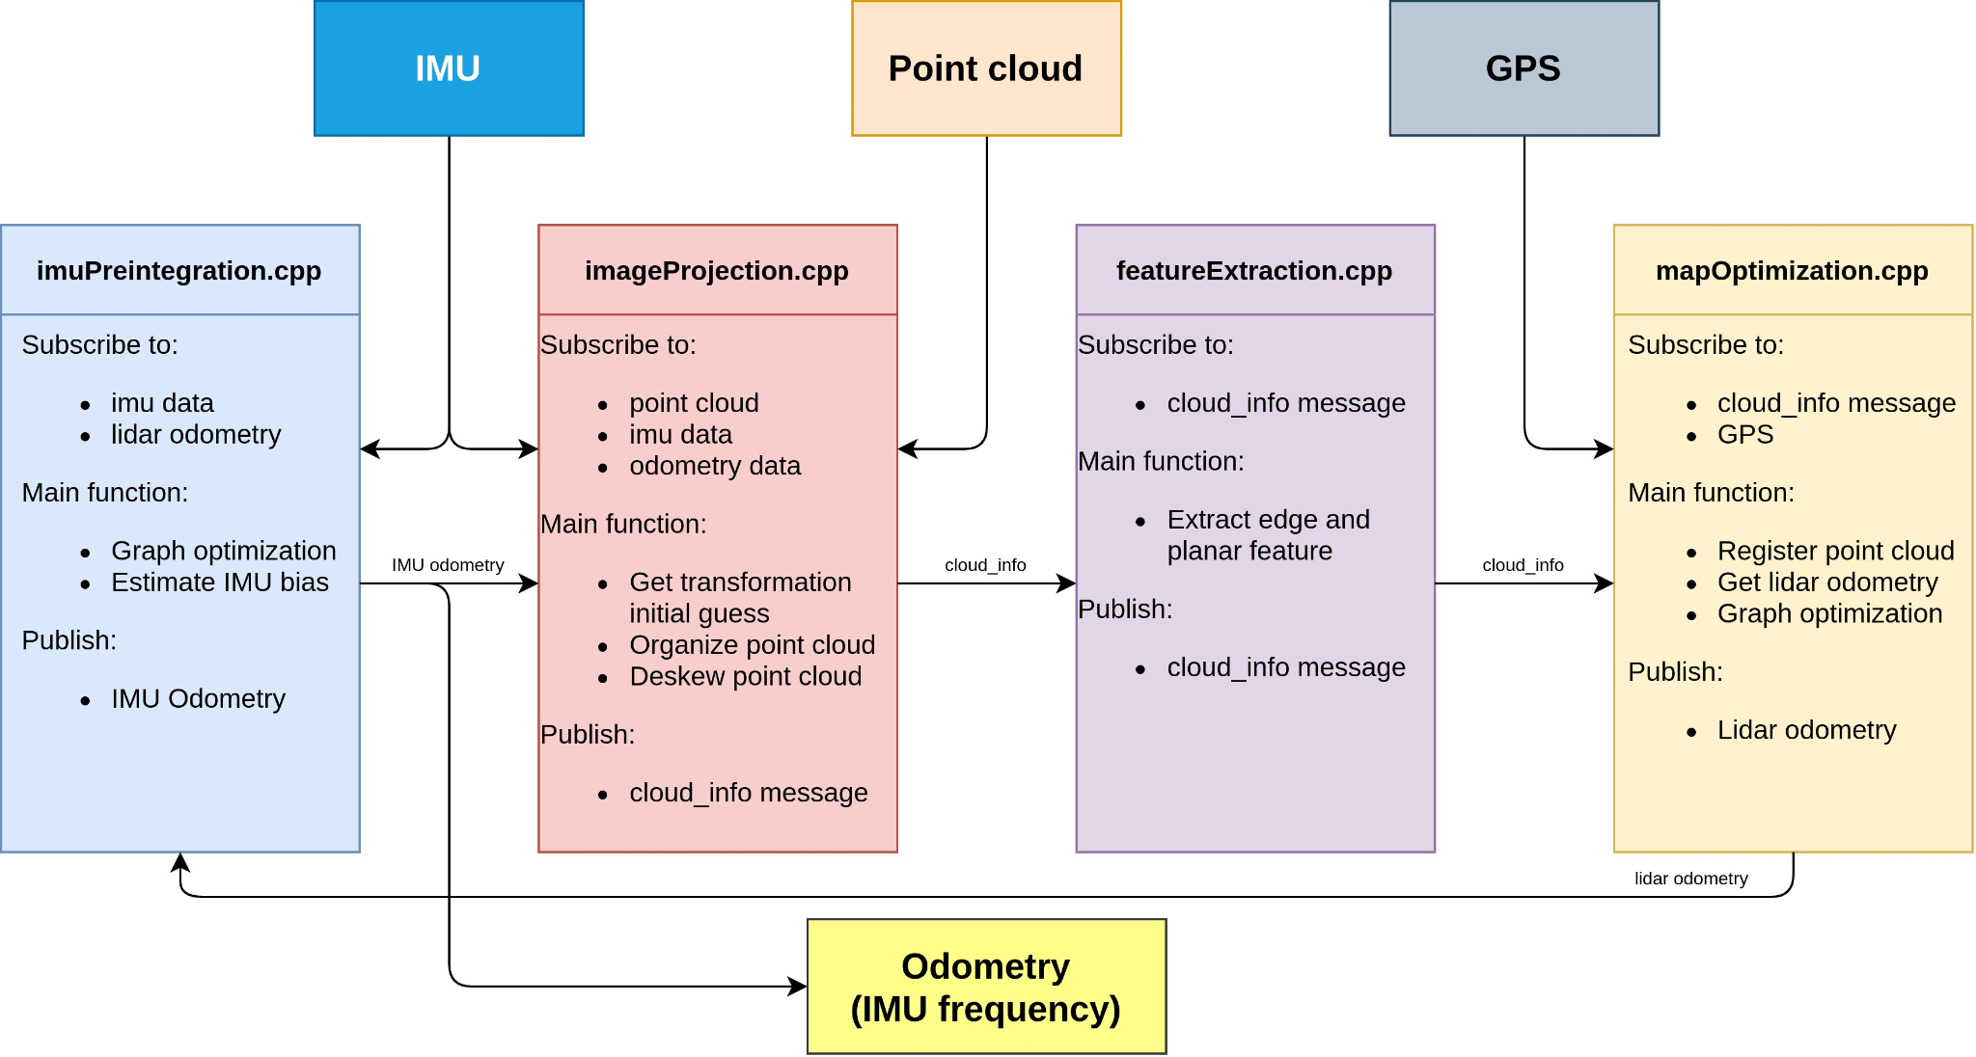
System Architecture
Figure 4 : System Architecture of LIO SAM

Slide 11
Factor Graphs:
Factor graphs are a class of graphical models in which there are variables and factors.
The variables represent unknown quantities in the problem, and the factors represent functions on subsets of the variables.
Edges in the factor graph are always between factors and variables, and indicate that a particular factor depends on a particular variable.
LIO SAM in a similar way formulates the SLAM problem as a factor graph
Allows multi-sensor fusion through different factor types including IMU, Lidar, GPS etc.

Slide 12
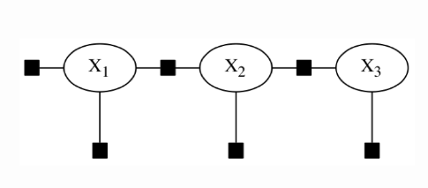
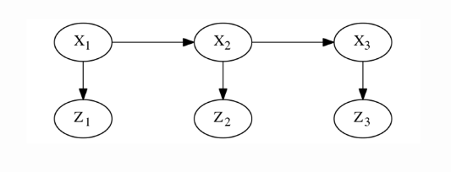
Factor Graphs:
Figure 5 : Constructing factor graphs using Baye’s Rule

Slide 13
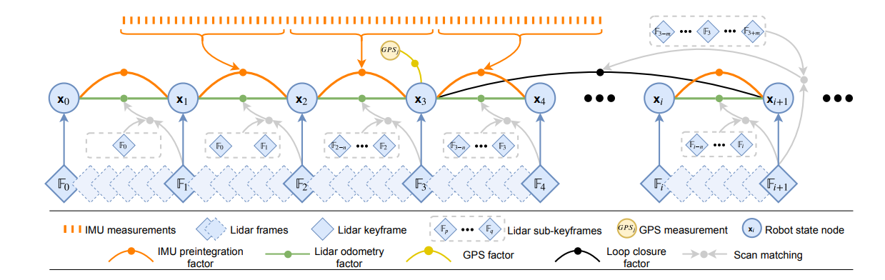
Figure 6 : Working factor graph principle of LIO SAM
Notes:
The system structure of LIO-SAM. The system receives input from a 3D lidar, an IMU and optionally a GPS. Four types of factors are introduced to construct the factor graph.: (a) IMU preintegration factor (b) lidar odometry factor (c) GPS factor (d) loop closure factor

Slide 14
Advantages over LEGO LOAM:
LIO-SAM | LeGO-LOAM
Integrates inertial sensors along with LiDAR, allowing for more robust estimation of motion and better handling of dynamic environments. | It is known for its computational efficiency, which can be advantageous in real-time applications.
It employs factor graph optimisation, a sophisticated mathematical method for dealing with uncertainties and improving map and localization estimations. | It's particularly useful in applications where a smaller area needs to be mapped or where real-time performance is critical.
It is capable of global optimization, refining the entire map and trajectory to find the best fit considering all available information. It's designed to fuse data from multiple sensors, which enhances accuracy and reliability. | It might be easier to implement for certain applications

Slide 15
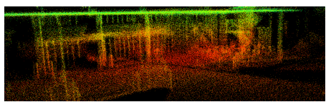

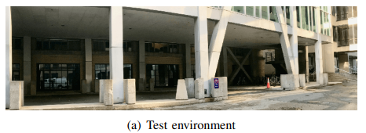
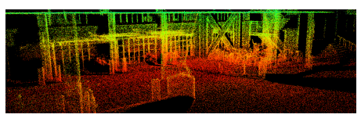
LOAM
LIO-SAM

Slide 16
Issues Faced:
Set-up and configuration issues: The original LIO SAM algorithm was developed for ROS ‘Melodic’. To run the algorithm on ROS ‘Noetic’ we had to make some changes.
OpenCV version compatibility: We updated the openCV version in the utility.h file from ‘#include <opencv/cv.h>’ to ‘#include <opencv2/opencv.hpp>’.
CMake version compatibility: The ‘set(CMAKE_CXX_FLAGS"-std=c++11")’ was changed to ‘set(CMAKE_CXX_FLAGS "-std=c++14")’.
Gtsam version compatibility: Occasional crashes during the map optimization process were observed, potentially related to GTSAM. Ensuring the correct version of GTSAM, as specified in the documentation, helped mitigate this issue to some extent.

Slide 17
Issues Faced:
Debugging and runtime issues:
Remapping the rostopics: Rostopics were remapped as required by the above-described convention while executing roslaunch commands and playing the data bags.
Random offset behavior in Odometry Estimates: We observed a randomized offset in the odometry estimates, suggesting intermittent misalignments. Certain tweaks to the synchronization algorithm were made, and the playback speed during rosbag playback (rosbag play) was adjusted to improve temporal consistency.
Synchronization of Sensor Data: ROS bags contain recorded sensor data with timestamps. Lowering the playback rate allows more time for the system to process and synchronize lidar and IMU data accurately. This can be crucial for algorithms that rely on precise temporal alignment between different sensor modalities.
Debugging and Visualization: Slowing down the playback rate facilitates easier debugging and visualization. Users can observe the algorithm's intermediate states, inspect visualizations in real time, and identify potential issues more effectively at a slower pace.
Parameter Tuning: Some algorithms might have parameters that need fine-tuning. Lowering the playback rate provides more time for parameter adjustments and allows users to observe the impact of these changes on the algorithm's performance.

Slide 18
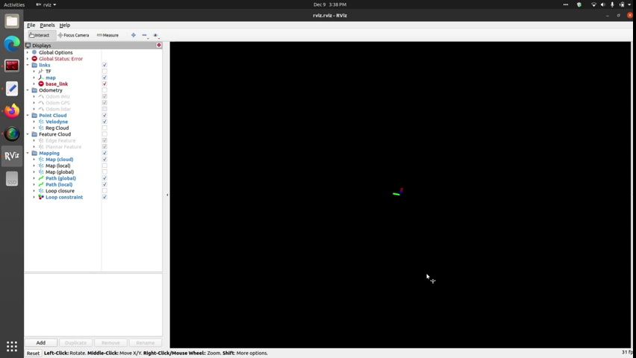
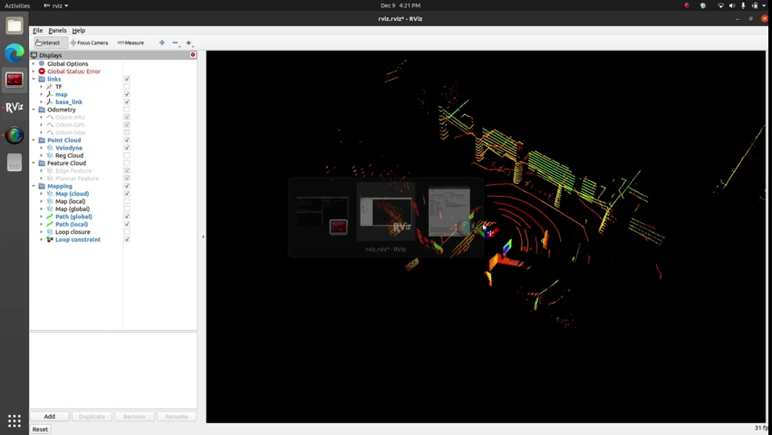
Rviz visualization on author datasets:
Park Dataset Video
Garden dataset Video

Slide 19
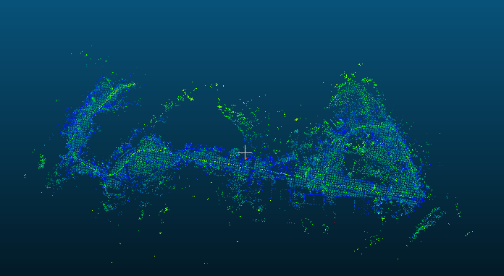
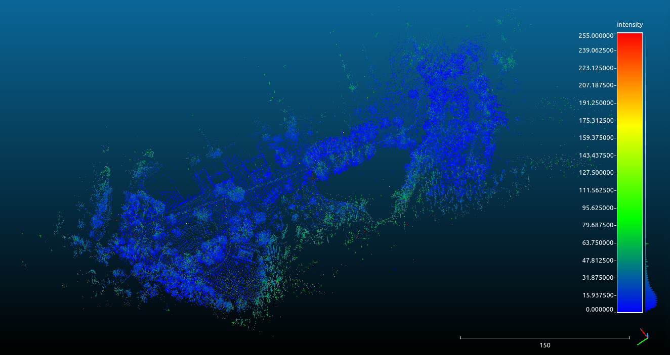
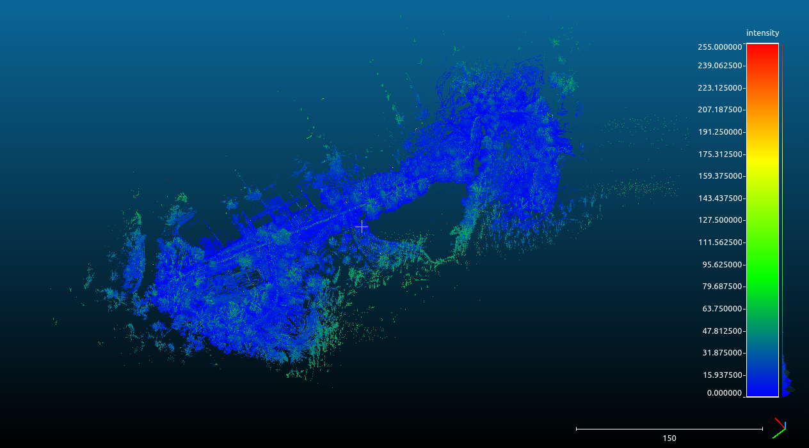
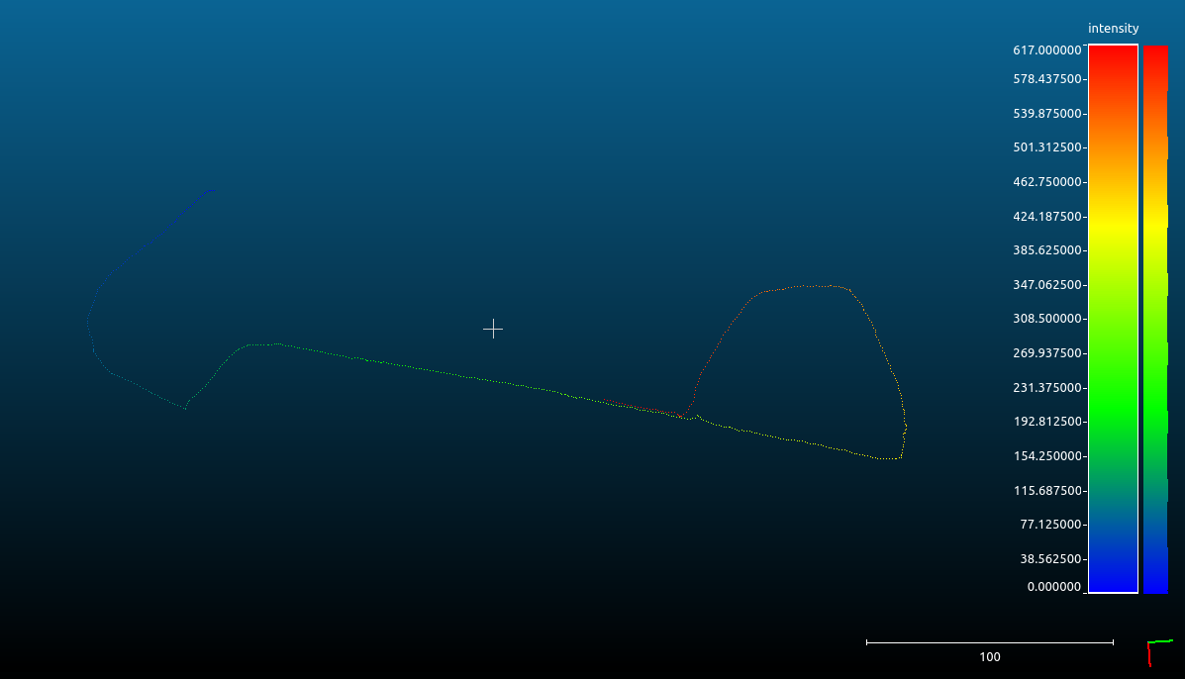
Cloud point visualization Park dataset
Here the points correspond to the corner/distinctive features of the environment.
Here the points correspond to the surface/continuous regions in the environment.
Visualization of the resulting trajectory.
Global map: Provides a high-level overview of the spatial layout, structure, and key features of the environment.

Slide 20
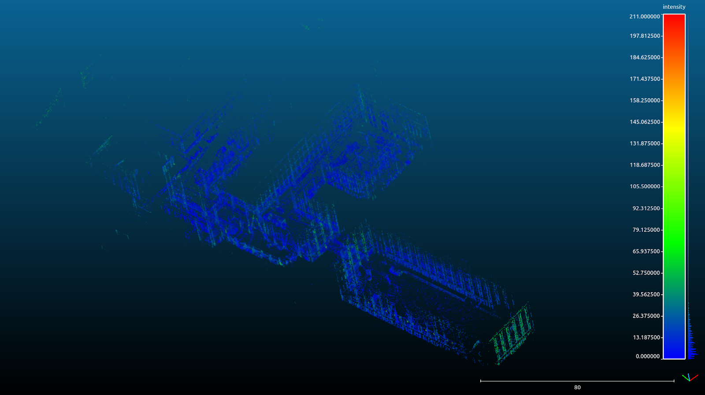
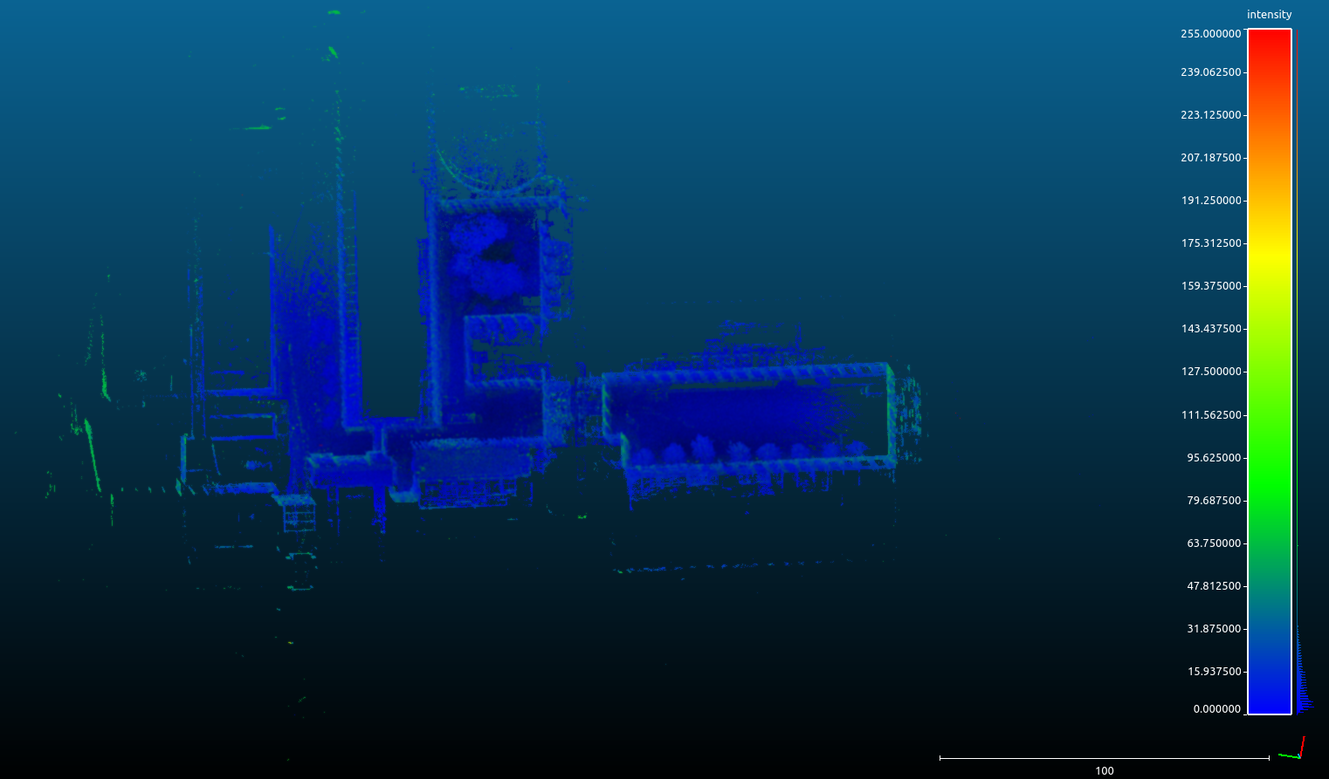
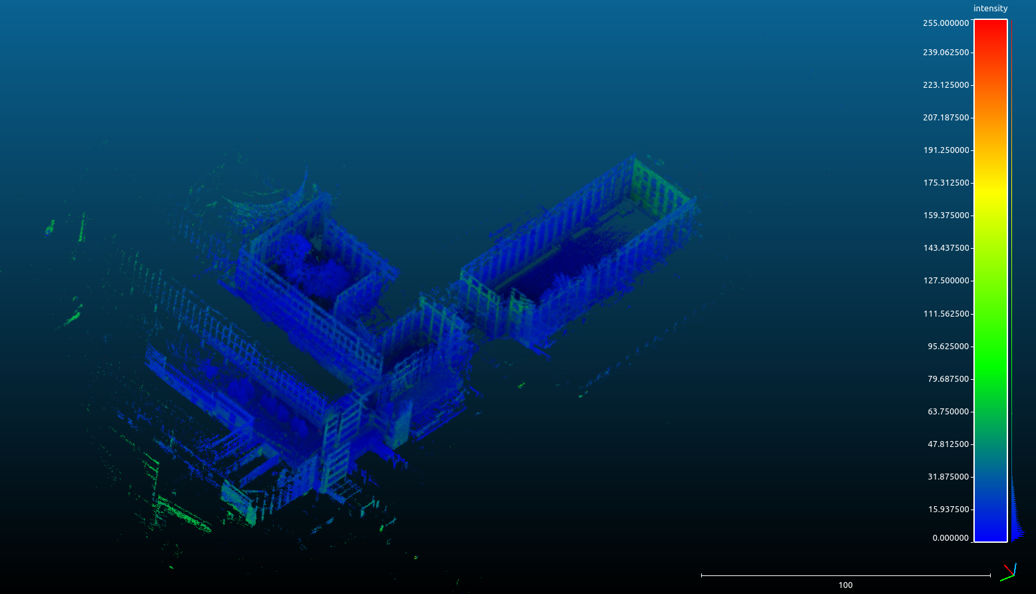
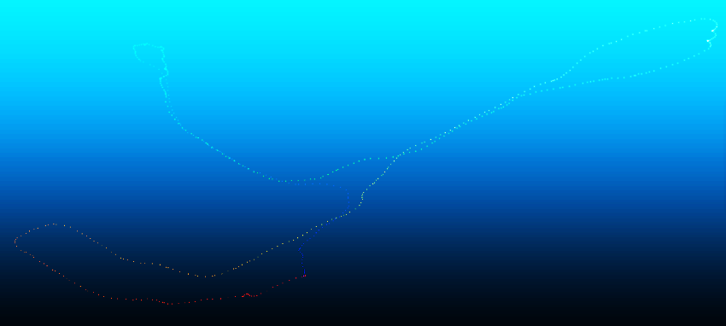
Cloud point visualization garden dataset
Here the points correspond to the corner/distinctive features of the environment.
Here the points correspond to the surface/continuous regions in the environment.
Visualization of the resulting trajectory.
Global map: Provides a high-level overview of the spatial layout, structure, and key features of the environment.

Slide 21
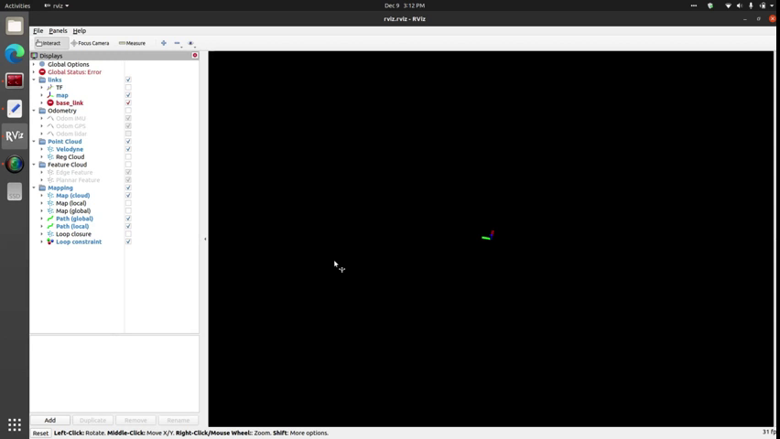
Rviz Visualization of NUance dataset (initial attempt)
Initial attempt video

Slide 22
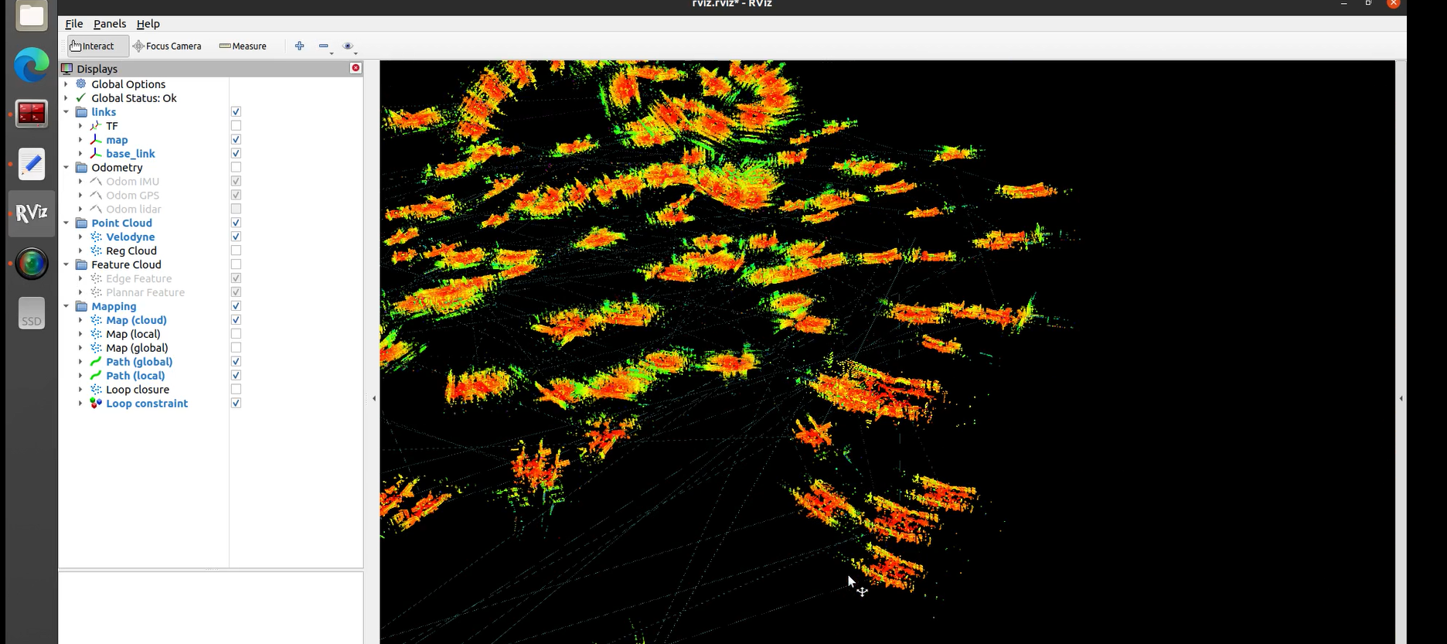
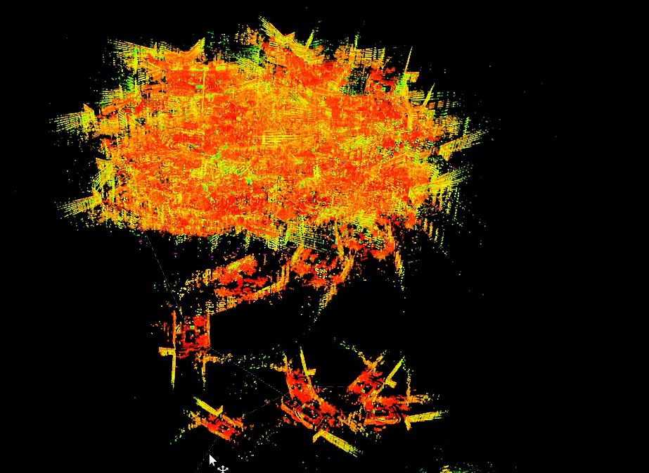
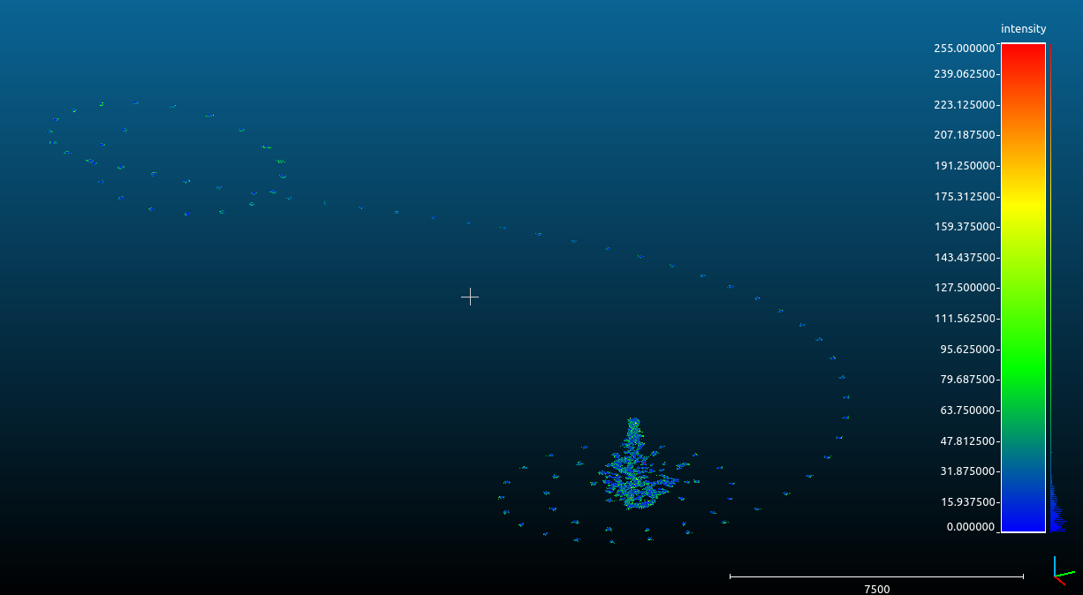
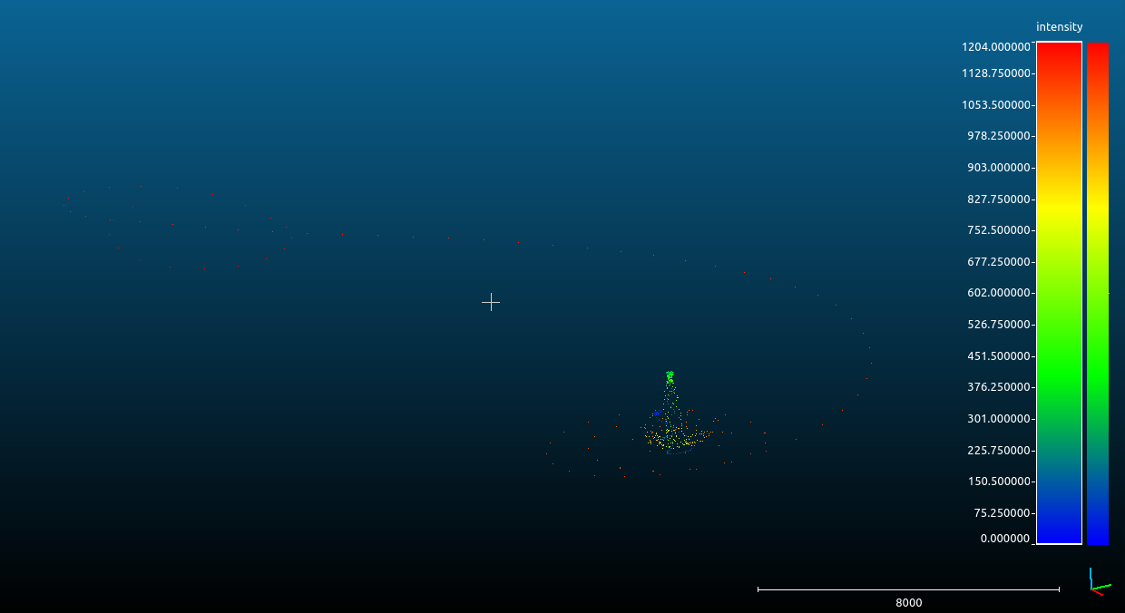
Cloud point visualization NUance dataset (initial attempt)
Our initial attempts at visualizing the mapping results of the NUANCE car dataset using Rviz. The resulting visualization is skewed over time. Further, problems in the IMU preintegration factor can also be inferred by observing the skewed point cloud maps.
The above images represent the global map and the trajectory taken. They are quite random. We cannot make much sense of them.

Slide 23
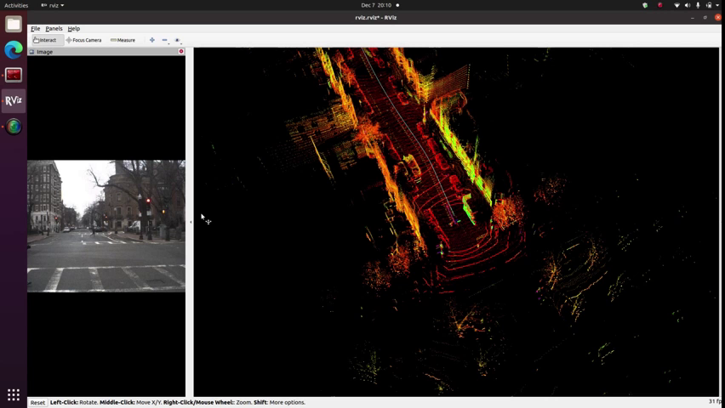
Rviz Visualization NUance dataset (successful attempt )
Results after changing the playback rate of rosbag to 1

Slide 24
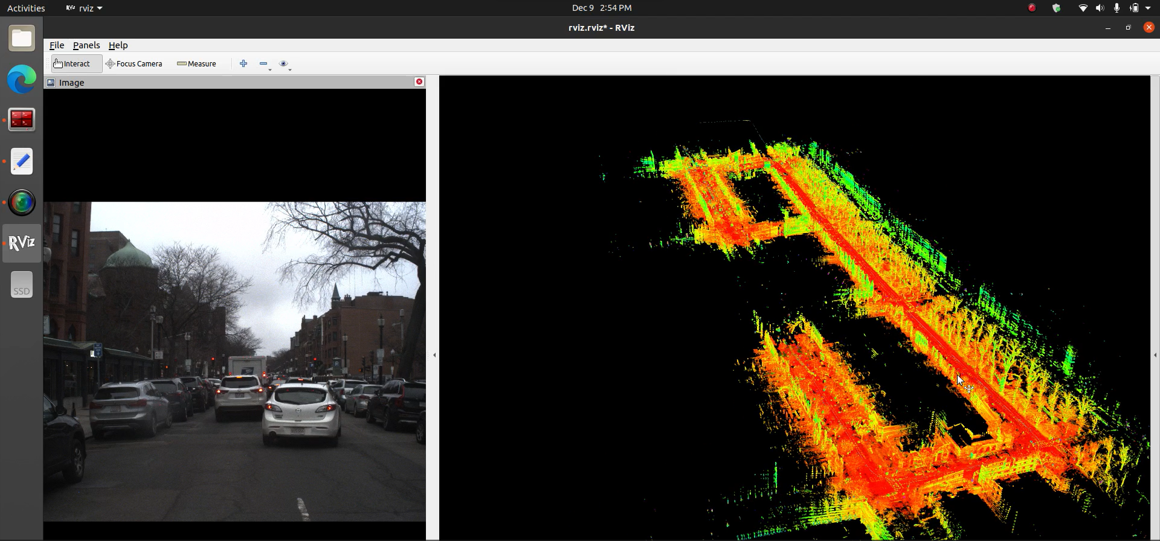
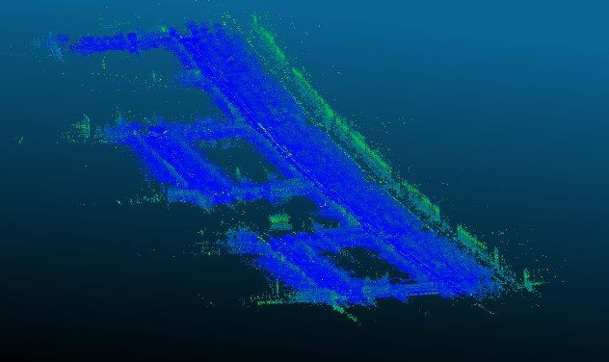
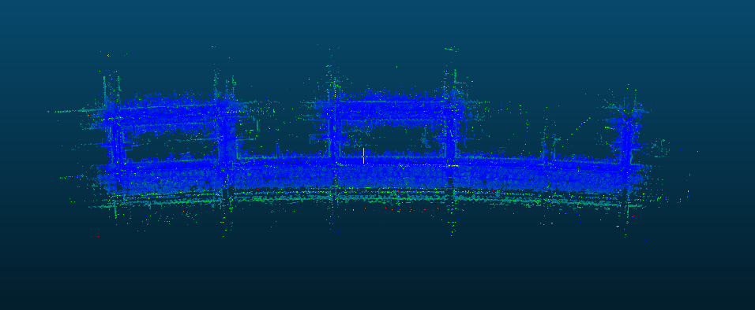
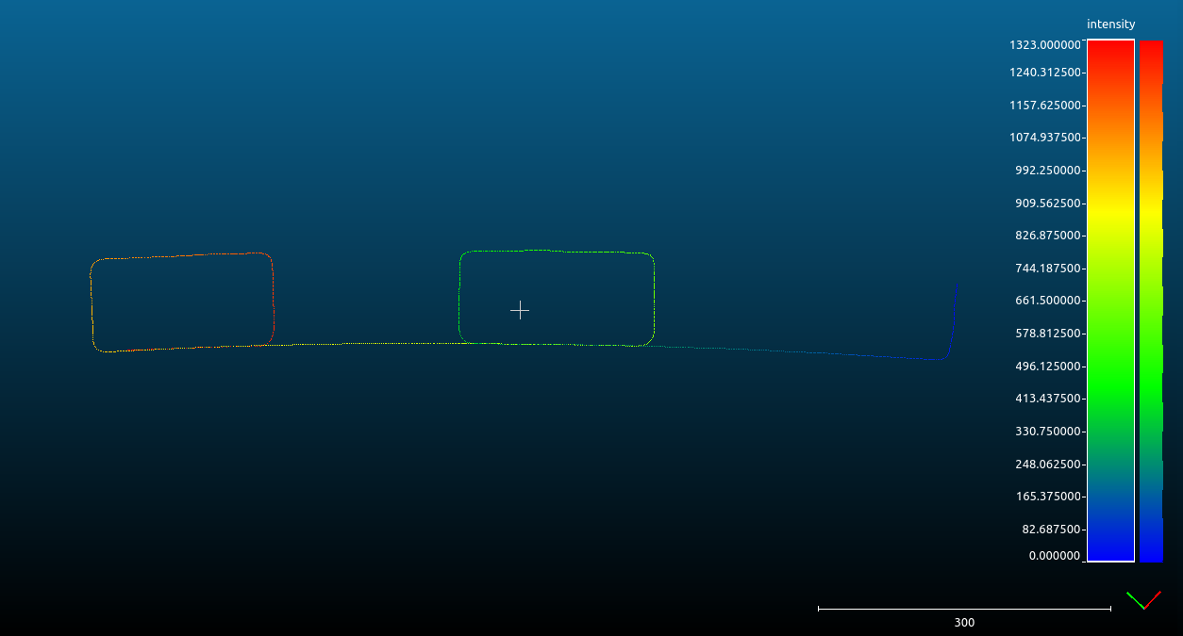
Cloud point visualization NUance dataset (successful attempt )
To overcome the issues we faced, we systematically tweaked the playback rate and other important parameters of the rosbag being played. These images show the corrected Rviz visualization
These images represent the global map and the trajectory taken saved as a PCD map.

Slide 25
Limitations:
LIO SAM does not work with the internal 6-axis IMU of Ouster lidar. We need to attach a 9-axis IMU to the lidar and perform data-gathering.
LIO SAM may have difficulty performing loop closure detection and incorporating other absolute measurements, such as GPS, for pose correction.
LIO SAM may have long-period drift issue in all three directions without GPS fusion.
Conclusion:
While Lego LOAM puts forth a novel approach for SLAM using LIDAR data, LIO SAM leverages the advantages of LIDAR Odometry and IMU’s Inertial data to deal with the challenges of SLAM
Our tests have shown that to get the best results, careful parameter tuning, downsampling techniques, and hardware considerations are essential.
To sum up, LIO-SAM showed encouraging results in lidar-based odometry and mapping, with an emphasis on precise feature representation and real-time performance.
However the results, do show an imminent need of powerful computing resources in order to produce the efficient and accurate mapping results, which serves as one potential pitfall for its implementation.

Slide 26
References:
[1] T. Shan and B. Englot, "LeGO-LOAM: Lightweight and Ground-Optimized Lidar Odometry and Mapping on Variable Terrain," in IEEE/RSJ International Conference on Intelligent Robots and Systems (IROS), 2018.
[2] J. Zhang and S. Singh, “LOAM: Lidar Odometry and Mapping in Real-time,” in Robotics: Science and Systems, vol. 2, 2014.
[3] T. Shan, J. Wang, K. Doherty, and B. Englot, “Bayesian Generalized Kernel Inference for Terrain Traversability Mapping,” in Conference on Robot Learning (CoRL), 2018.
[4] T. Shan et al., "LIO-SAM: Tightly-coupled Lidar Inertial Odometry via Smoothing and Mapping," in IEEE/RSJ International Conference on Intelligent Robots and Systems (IROS), 2020.

Slide 27
Thank You

